Slide 1
Table of contents
Week 2
Name of the lesson: True Innovators
Lesson objectives:
Read and understand basic personal information in bios.
Provide personal and professional information about another person.
Present someone orally.
Use the simple present (2nd person) and expressions like “This is...” to introduce someone.

Slide 2
This lesson will be
recorded
Notes:
Remember that all lessons are recorded.

Slide 3
Week 2 – LEVEL 1
True innovators

Slide 4


Weekly plan
Part I
Part II
True innovators
Written focus
Describe another person with basic personal and professional information (short bio).
Read bios with basic professional information.
Present and describe another person.
Notes:
Each weekly plan includes 2 classes. The second class is always practice-based, with a focus on oral or written work.

Slide 5
Today’s agenda
Discuss characteristics of innovators
(individual + whole class)
Listen to an extract and watch a video about innovators (pair work + whole class)
Identify useful phrases and structures
(whole class)
Describe an innovator
(group + individual)

Slide 6
Part I -
Getting started

Slide 7

Look at the image. What do you see?
Type your answer in the chat.
Image by rawpixel.com on Freepik
Notes:
T will guide the answers and ask the following questions to Ls (using Spanish when needed): What do the symbols on their heads mean? What are they doing/ planning to do? Where are they?. After Ls provide some answers, T may try to elicit other information, such as: What do we call people who have good ideas? More competent Ls could be asked to watch this video in breakout rooms: https://www.youtube.com/watch?v=IiyMkOfycOg . After watching they may have a short discussion to add new concepts to the idea of innovations as “uncommon dots”.

Slide 8

Let’s think together
Which of the following is more important for an innovator? Type your answer or speak up.
Clever/ intelligent - Imaginative - Persistent
Type your answer in the chat.
ESTIMATED TIME: 5 minutes
Notes:
The answer here is that the three may be equally important for any innovator. Answers can be free or T may ask Ls to rank their answers from 1 to 3, according to how important they consider each trait and then reveal that probably the three are equally important. For more competent Ls T may ask them to justify their answers.
¿Cómo crear encuestas de zoom? Disponible en este video.
El docente generará una encuesta de zoom para que los estudiantes respondan. Esto es una actividad de comprobación.
Sugerimos:
Utilizarlo antes del break para que los estudiantes puedan votar en la encuesta antes de ir al mismo.
Al regresar, mostrar los resultados a los estudiantes.
Si hay buena respuesta de este recurso, se recomienda utilizarlo de forma orgánica en más instancias de la clase.

Slide 9
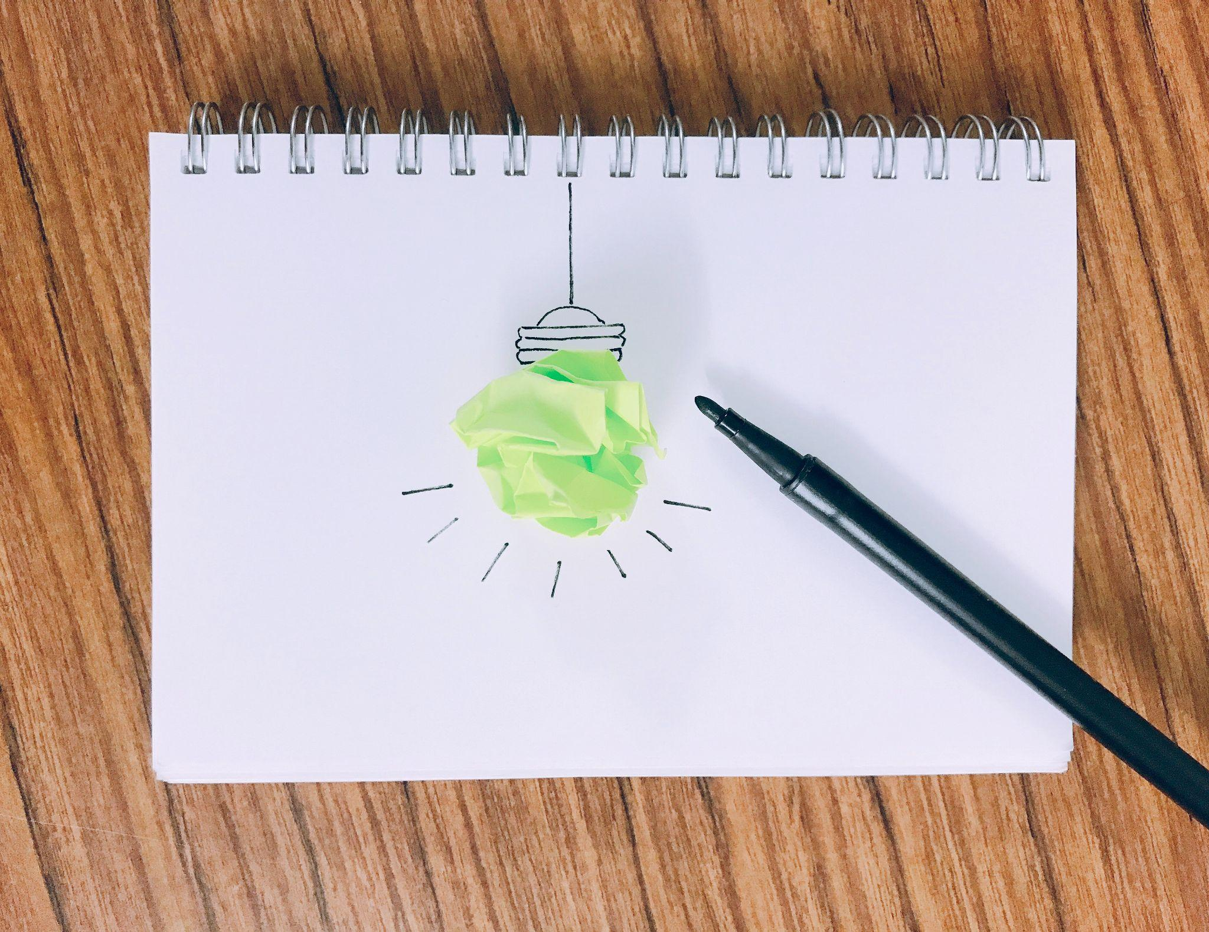

Innovators
Let’s listen
Notes:
For more competent Ls T may do a quick brainstorm on names to anticipate what comes next.

Slide 10

Listening comprehension
Now listen again and complete the missing words you hear. Then, share your answers in the chat.
Estimated time: 5 minutes
Notes:
Usar para Actividades en clase.

Slide 11
CLASS ACTIVITY
Listening comprehension
1. An innovator ______________ new and better ideas.
2. An innovator ___________ new ways of doing things.
3. An innovator _____________creativity to solve problems.
4. Innovators______________ important in society.
5. They ___________ make things better and bring new and exciting changes.

Slide 12
CLASS ACTIVITY (Key)
Now listen again and complete the missing words you hear.
has
1. An innovator ______________ new and better ideas.
2. An innovator ___________ new ways of doing things.
finds
uses
3. An innovator _____________creativity to solve problems.
4. Innovators______________ important in society.
are
5. They ___________ make things better and bring new and exciting changes.
help

Slide 13
Communicative focus

Slide 14

Group work: introducing someone
Read the phrases. Decide which options are used to present a person in English. Type your choices in the chat.
This is Mark
Let me introduce Mark
I want to introduce you to Mark
Estimated time: 5 minutes
Notes:
The answer here is that the three may be equally important for any innovator. Answers can be free or T may ask Ls to rate their answers from 1 to 3, according to how important they consider each trait and then reveal that probably the three are equally important. For more competente Ls T may ask them to justify their answers.
ACTIVIDAD que se puede llevar a cabo en formato “Breakout Rooms”
Para el profesor:
Crear breakout rooms para los equipos. De no saber cómo, favor de revisar el siguiente tutorial:
En PPT: https://docs.google.com/presentation/d/1vieCGzAPuYf5vWsu8Xgbn_2Ax4QNLnXO/edit?usp=sharing&ouid=103396586770751045195&rtpof=true&sd=true
En video: https://www.youtube.com/watch?v=PJL8iYTIY3E&feature=youtu.be
Se recomienda que los equipos sean de números pares, máximo 4 participantes por equipo y de así requerirse, ser acompañados por un tutor.

Slide 15
Role play
In your group, choose someone who will present the rest of the people in the group. Use a variety of the phrases given.
Estimated time: 10 minutes
Notes:
T gives students some moments to think of their answers and then share them in the chat.

Slide 16
Video time
Watch the video and decide if the following sentences are true or false.
Estimated time: 10 minutes
Notes:
Usar para Actividades en clase.

Slide 17
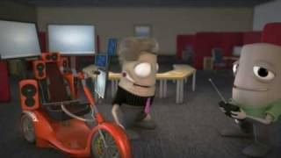
Innovators
Let’s watch
What Does an Innovator Actually Do?
Notes:
For more competent Ls T may do a quick brainstorm on characteristics to anticipate what comes next.

Slide 18
CLASS ACTIVITY
True or false?
An innovator generates changes.
An innovator creates expensive things.
Innovators always do the same things.
Notes:
T can ask more competent Ls to explain the false options and give room for more discussion.

Slide 19
CLASS ACTIVITY
Key
An innovator generates changes. TRUE
An innovator creates expensive things. FALSE
Innovators always do the same things. FALSE

Slide 20
Video transcript
(people having different conversations) Speaker 1: So, what do you do, Simon? Simon: Oh, I’m in banking, and you? Speaker 1: Scientist…lots of research! Simon: Interesting! Speaker 1: I’m in manufacturing, Speaker 2: What do you do, Jeff? Jeff: I’m an innovator, Speaker 2: Ouch, it sounds expensive! Speaker 3: We're too busy with our day jobs. Speaker 4: It's all too risky, we stick to what we've always done. Speaker 5: So, what does an innovator actually do? Jeff: Oh, well, I am… Speaker 1: Ah, you're an inventor! Speaker 2: He's a motivator! Speaker 3: No, he's one of those blue-sky thinkers… | Jeff: Well, actually, my job entails ideas successfully applied to introduce and facilitate the output of the process through transformation and implementation…what I’m trying to say is that, through new methods, ideas or products, we can all create changes that make a difference Speaker 4: Oh, can innovation help to improve efficiency? Jeff: Well, yes! Speaker 1: Can it help with adapting to ever-changing customer requirements? Jeff: Absolutely! Speaker 2: Access new markets? Jeff: Oh yes! Speaker 3: Can you help us to stand out from our competitors? (people having different conversations)
Notes:
This is the transcript of the video, it can be used to expand on a certain aspect of language, to clarify meaning or for expansion tasks if there is time. This transcript can be used, even without watching the video to do some role-playing in the class. Each L can read a line.

Slide 21

Break-time
We’ll be back in 10 minutes!

Slide 22


Discussion
Discuss the following phrase:
The future belongs to the curious.
Notes:
For weaker Ls T may allow the discussion in Spanish and type some key words in the chat to help. For more competent Ls, T gives more room for discussion.

Slide 23
Discussion
Consider the following for your discussion:
1. A successful innovator is always curious.
2. Innovators think a lot about the future.
Notes:
For weaker Ls T may allow the discussion in Spanish and type some key words in the chat to help. For more competent Ls, T gives more room for discussion.

Slide 24

Collaborative task
Listen to the first part of a bio about an innovator. Type in the chat any phrases you can catch.
Estimated time: 5 minutes
Notes:
For more competent learners, T can ask to do the task in SLide 24 individually and then share their answers. Weaker learners may do this task as a whole class.

Slide 25
Collaborative task
Listen to the second part of a bio about an innovator. Type in the chat any phrases you can catch.
Estimated time: 5 minutes
Notes:
For more competent learners, T can ask to do the task in SLide 24 individually and then share their answers. Weaker learners may do this task as a whole class.

Slide 26
Complete the text
Read the text and fill in the gaps
Estimated time: 10 minutes
Notes:
Usar para Actividades en clase.

Slide 27
Complete
Mira Murati …… (1) a technology executive. She is famous for her contributions to the field of artificial intelligence. She was born and raised in San Francisco. She …… (2) a Bachelor of Engineering degree.
Mira worked in different companies, like Tesla and OpenAI. She worked in the development of ChatGPT, a cutting-edge language model.
Mira …… (3) fluent in English, Italian, and Albania. In her spare time, she …… (4) reading fiction, playing the piano, making chocolate, and dancing salsa.

Slide 28
Read the bio and check.
Mira Murati is a technology executive. She is famous for her contributions to the field of artificial intelligence. She was born and raised in San Francisco. She holds a Bachelor of Engineering degree.
Mira worked in different companies, like Tesla and OpenAI. She worked in the development of ChatGPT, a cutting-edge language model.
Mira is fluent in English, Italian, and Albania. In her spare time, she enjoys reading fiction, playing the piano, making chocolate, and dancing salsa.

Slide 29
What is a bio?
A bio is usually a short biography. It is a written description of a person. It includes professional and personal details.

Slide 30
Language and vocabulary focus
Third-person singular form to describe | Plural forms to describe | Vocabulary to describe
Verb to be: is Other verbs: has, does, holds, enjoys, generates, creates, finds, generates, creates, uses | Verb to be: are Other verbs: have, do, help, create, | Adjectives: clever, imaginative, intelligent, persistent. Other phrases: new and better ideas, new ways of doing things,
Estimated time: 10 minutes

Slide 31
Collaborative task
In separate groups, describe an innovator in two sentences.
Use a verb in the singular and some vocabulary given. When you join the class, read or type your sentences, so the rest can guess.
Estimated time: 15 minutes
Notes:
For more competent learners, T sends them to breakout rooms directly. Weaker learners may do this task in groups or as a whole class.

Slide 32

Recap

Slide 33
True or false?
A true innovator is a person with difficult ideas.
F
A true innovator has new and creative ideas.
Answer in the Zoom chat
Notes:
T elicits or else provide learners with some of the characteristics of innovators seen in the class by way of a revision. If necessary, the slide with the “Language and vocabulary focus” chart may be shown again. For more competent Ls T may first elicit an alternative adjective that makes more sense here.

Slide 34
Break-time
We’ll be back in 15 minutes!

Slide 35
Part II -
Getting started

Slide 36
Written focus

Slide 37

Written focus lab
We will carry out different class activities to understand and put into practice the theoretical concepts we have seen.
In what way?
First, we will make a collaborative brainstorming to revise together some theoretical concepts and ask doubts. Then, you will work individually. When you are done, you will present your work and receive feedback. Finally, you will work individually to revise concepts with on-demand tasks.
Estimated time: 80 minutes + 10-minute break

Slide 38
Step by step
1
2
3
Step 1
Step 2
Step 3
Revise collaboratively
and clear up doubts.
Estimated time: 10 minutes
Work in small groups, share your work and receive feedback.
Estimated time: 60 minutes
Revise concepts with on-demand tasks.
Estimated time: 10 minutes

Slide 39

Let’s get started!

Slide 40
Whole class
Step 1
Collaborative revision and doubts. We’ll revise together the contents seen last class. As we read together, you will ask any questions orally or type them in the chat.
Estimated time: 10 minutes

Slide 41
What is a bio?
A bio is usually a short biography. It is a written description of a person. It includes professional and personal details.

Slide 42
Language and vocabulary focus
Third-person singular form to describe | Plural forms to describe | Vocabulary to describe
Verb to be: is Other verbs: has, does, holds, enjoys, generates, creates, finds, generates, creates, uses | Verb to be: are Other verbs: have, do, help, create, | Adjectives: clever, imaginative, intelligent, persistent. Other phrases: new and better ideas, new ways of doing things,

Slide 43
Any questions?

Slide 44
Step 2
Work in small groups, share your work and
receive feedback.
Estimated time: 60 minutes

Slide 45

STEP 2 - PART I
Individual brainstorming and text organization
Description of the activity.
Write down useful vocabulary and any language you need to write your text before entering breakout rooms.
Estimated time: 5 minutes
Notes:
Usar para las subsiguientes slides de Actividades en clase.

Slide 46

Text organization tips
Organize your ideas in the text.
Use the vocabulary and language we revised.
Mark any ideas you brainstormed and want to share in breakout rooms.

Slide 47
STEP 2 - PART II
Written task
Write a short description of an innovator.
Use some structures and vocabulary
from last class.
Include basic personal and professional information.
Description of the activity.
Use this part of the class to create a collaborative text following the tasks instructions. Create a Google Doc where you can all work together.
Estimated time: 25 minutes
Notes:
This is a task that is meant to be done in groups or in pairs for less competent learners. In groups with more competent learners, T may ask to hand in a longer text and include other specific characteristics like nationality, big accomplishments, etc.

Slide 48
Revise and check
Use this time to re-read your text, correct mistakes and check the final version
Estimated time: 5 minutes

Slide 49
Text revision tips
Are the ideas organized in a logical order?
Is the vocabulary and language OK?
Are ideas repeated? How can we improve that?
Do we need to include more information?

Slide 50
Break-time
We’ll be back in 10 minutes!

Slide 51
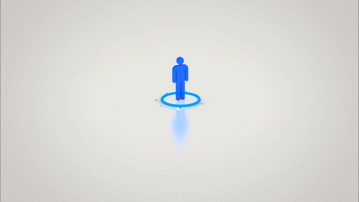
Let’s share your work with the class!

Slide 52
Step 3
Revise concepts with
on-demand tasks.
Estimated time: 20 minutes

Slide 53
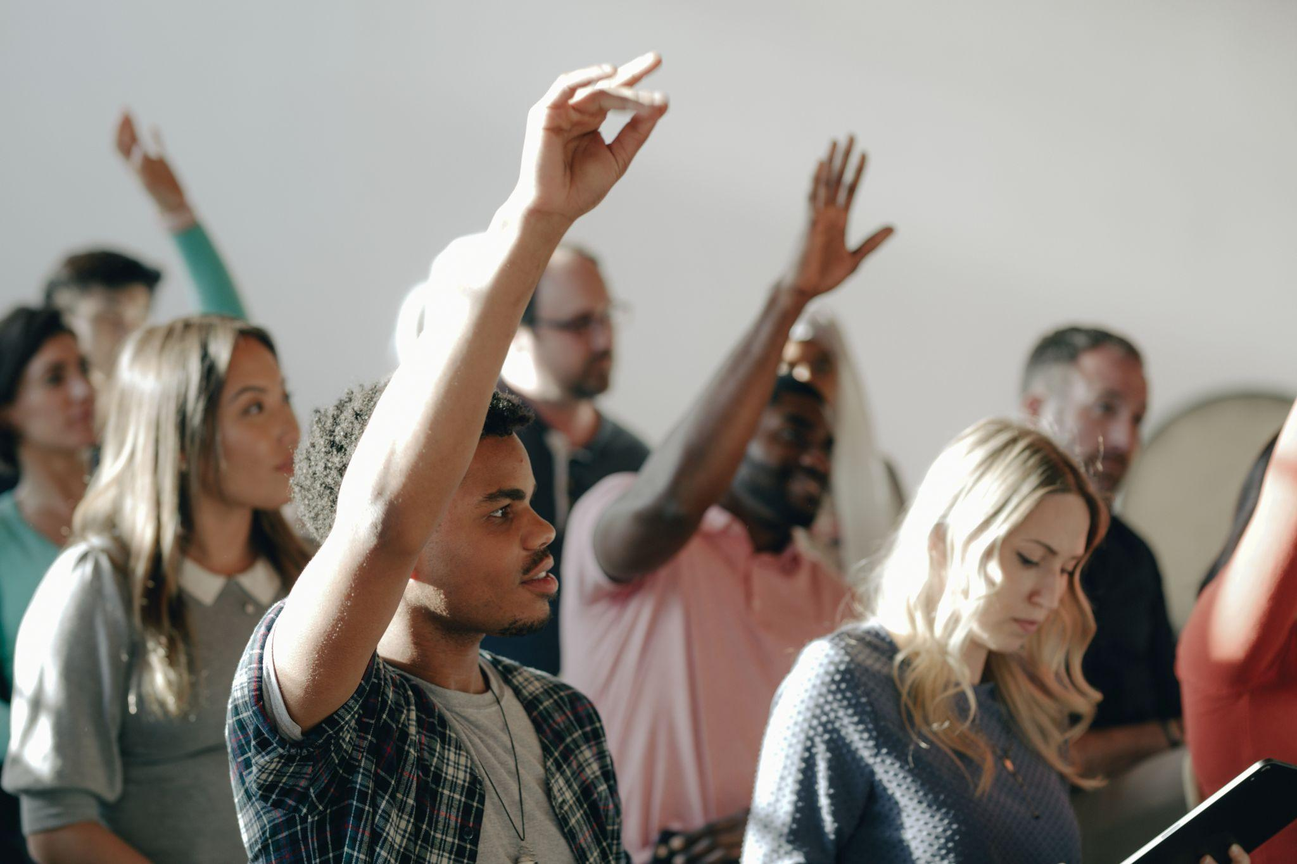
STEP 3
Whole class
Description of the activity.
Use this part of the class to share your work with the rest of the class and receive feedback from peers and teacher.
Estimated time: 25 minutes
Notes:
This is a task that is meant to be done in groups or in pairs for less competent learners. In groups with more competent learners, T may ask to hand in a longer text and include other specific characteristics like nationality, big accomplishments, etc.

Slide 54
ON-DEMAND

Slide 55
Fill in the gaps. For the first gap in each exercise, use an appropriate vocabulary word from the list provided. For the second, use a verb in the simple present from the list or invent your own.
Vocabulary words: visionaries - activist - innovators - entrepreneur - advocate
Verbs: innovate - lead - bring - make - fight
Elon Musk is regarded as one of the great __________ of our time. He __________ innovative companies like SpaceX to success.
Bill Gates is one of the prominent __________ in the technology industry. He __________ significant advancements in computer technology.
3. Greta Thunberg is an inspiring __________ in the fight against climate change. She __________ global attention for environmental action.
Malala Yousafzai is an __________of girls' education. She __________ for equal rights.
Jeff Bezos, the founder of Amazon, is a prominent __________. He founded largest online marketplaces and constantly __________ in various industries.

Slide 56
Fill in the gaps. For the first gap in each exercise, use an appropriate vocabulary word from the list provided. For the second, use a verb in the simple present from the list or invent your own. (key)
Elon Musk is regarded as one of the great innovators of our time. He leads innovative companies like SpaceX to success.
Bill Gates is one of the prominent visionaries in the technology industry. He makes significant advancements in computer technology.
Greta Thunberg is an inspiring activist in the fight against climate change. She brings global attention for environmental action.
Malala Yousafzai is an advocate of girls' education. She fights for equal rights.
Jeff Bezos, the founder of Amazon, is a prominent entrepreneur. He founded big online marketplaces and constantly innovates in different industries.

Slide 57
Complete the dialogue. Use an appropriate form of the verb in brackets. Then read the dialogue to practise.
Sam: Hey everyone, this _________ (be) our new colleague, Sarah. She __________ (work) as a software engineer.
Laura: That's great! Welcome, Sarah. So, what programming languages do you know?
Sarah: Thank you! I __________ (specialize) in Java and Python. I also __________ (have) experience with C++.
Tommy: Excellent! We ________ (use) Java and Python a lot in our projects. It ____ (be) good to have your expertise.
Laura: Sarah, can you tell us more about your background?
Sarah: Sure! I graduated from UBA University with a degree in Computer Science. I ___ (be) passionate about technology.
Tommy: We __________ (be) glad to have you on our team, Sarah.
Sarah: Thank you! I __________ (look) forward to working with all of you.

Slide 58
Complete the dialogue. Use an appropriate form of the verb in brackets. Then read the dialogue to practise. (key)
Sam: Hey everyone, this is our new colleague, Sarah. She works as a software engineer.
Laura: That's great! Welcome, Sarah. So, what programming languages do you know?
Sarah: Thank you! I specialize in Java and Python. I also have experience with C++.
Tommy: Excellent! We use Java and Python a lot in our projects. It is/’s good to have your expertise.
Laura: Sarah, can you tell us more about your background?
Sarah: Sure! I graduated from UBA University with a degree in Computer Science. I am/‘m passionate about technology.
Tommy: We are/’re glad to have you on our team, Sarah.
Sarah: Thank you! I look forward to working with all of you.

Slide 59
Underline uses of the simple present (affirmative) in the text below. Then use it as a model to create a similar text and introduce a colleague you know.
Introducer: Hello, everyone! I'd like to introduce you to our new colleague, Anna. She works as a UX Writer.
Anna: Hi, everyone! Nice to meet you all.
Introducer: Anna, can you tell us a bit about your role as a UX Writer? What kind of content do you create?
Anna: Sure! As a UX Writer, I create clear and concise text for user interfaces. I write error messages, button labels, and tooltips.
Introducer: That sounds interesting. Where did you study UX writing?
Anna: I studied Technical Communication and Design at CEU University in San Pablo.
Introducer: That's great! What tools or software do you use as a UX Writer?
Anna: I work with design and prototyping tools like Sketch and Figma. I also use content management systems to integrate the text into the interface.
Introducer: Great! We're excited to have you on board, Anna. Is there anything else you would like to share with the team?
Anna: Thank you for the warm welcome. I'm passionate about creating meaningful user experiences and collaborating with cross-functional teams. I'm looking forward to working with all of you.

Slide 60
Underline uses of the simple present (affirmative) in the text below. Then use it as a model to create a similar text and introduce a colleague you know. (key)
Introducer: Hello, everyone! I'd like to introduce you to our new colleague, Anna. She works as a UX Writer.
Anna: Hi, everyone! Nice to meet you all.
Introducer: Anna, can you tell us a bit about your role as a UX Writer? What kind of content do you create?
Anna: Sure! As a UX Writer, I create clear and concise text for user interfaces. I write error messages, button labels, and tooltips.
Introducer: That sounds interesting. Where did you study UX writing?
Anna: I studied Technical Communication and Design at CEU University in San Pablo.
Introducer: That's great! What tools or software do you use as a UX Writer?
Anna: I work with design and prototyping tools like Sketch and Figma. I also use content management systems to integrate the text into the interface.
Introducer: Great! We're excited to have you on board, Anna. Is there anything else you would like to share with the team?
Anna: Thank you for the warm welcome. I'm passionate about creating meaningful user experiences and collaborating with cross-functional teams. I look forward to working with all of you.

Slide 61
See you next class!

Slide 62
Today’s agenda - checkout
We discussed characteristics of innovators (individual + whole class)
We listened to an extract and watched a video about innovators (pair work + whole class)
We identified useful phrases and structures
(whole class)
We described an innovator
(group + individual)
Notes:
The idea with the agenda is two-fold: to make a revision of what they did in the class and to use the language in a meaningful way.

Slide 63
See you next class!

